Slide 1



USER DEFINED FUNCTIONS IN R
Reinpeter Momanyi
21st November 2024

Slide 2
Contents
1. Introduction
Definition, Why?, Types
2. Built-in Functions in R
Examples
Process
5. Nested Functions
Definition
3. Creating Functions in R
Structure/Components
4. Calling Functions in R
6. Practicals
Guiding principles
Demo of created functions
Examples

Slide 3
1. Introduction
What is a function?
An object containing multiple interrelated statements that are run together in a predefined order every time it is called.
Avoid the repetition of the same block of code frequently used.
Types of functions
Built-in
Why create functions?
Created by the user (user-defined).
To automate the performance of a particular task.
Make the code more readable and reproducible.
Prevent inevitable and hard-to-debug errors related to copy-paste operations.
Makes code modular.
Functions from external packages
Notes:
Built-in functions in R come predefined and are readily available without requiring explicit definition.
Anonymous functions, or lambdas, lack a formal name and are defined using the function() keyword without assignment to a variable. They are instrumental in scenarios where a function needs to be passed as an argument to another function, such as with apply() and lapply() functions in R.
Object-oriented programming system, S3 methods/S4 methods/S7 methods enable the definition of functions tailored to handle specific classes of objects. These methods are identified by the class of their first argument, facilitating polymorphic behaviour within R.

Slide 4
2. Built-in Functions in R
Some of most popular helpful built-in functions in R used for various purposes are;
min(), max(), mean(), median() – return the minimum / maximum / mean / median value of a numeric vector, correspondingly
sum() – returns the sum of a numeric vector
str() – shows the structure of an R object
print() – displays an R object on the console
ncol(), nrow() – returns the number of columns/rows of a matrix or a dataframe
length() – returns the number of items in an R object (a vector, a list, etc.)
sort() – sorts a vector in ascending or descending (decreasing=TRUE) order
file.exists() – returns TRUE or FALSE depending on whether or not a file exists in the defined working directory

Slide 5
3. Creating Functions in R
Source: https://www.dataquest.io/blog/write-funtions-in-r/
i. To declare a user-defined function in R, we use the keyword function()
ii. Main components of a function are: function name, parameters, and function body.
Notes:
If you need a certain functionality that can be reused but is not readily available in R, then you can create it on your own.

Slide 6
3. Contd’
Function Name
Name of the function object stored in the R environment after the function definition and used for calling that function.
Should be concise but clear and meaningful so that the user who reads our code can easily understand what exactly this function does.
Parameters/Arguments
Variables in the function definition placed inside the parentheses and separated with a comma.
Function Body
Set of commands inside the curly braces that are run in a predefined order every time we call the function.
Can be set to default values inside the function definition, then can be reset when calling the function.
A function can have no parameters/arguments.
We can drop the curly braces if the function body contains a single statement.

Slide 7
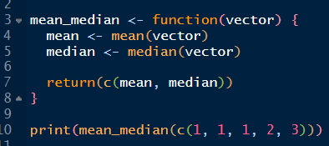
3. Contd’
i. R function automatically returns the last evaluated expression in the function body.
ii. If we need to return more than one result from a function, we can explicitly include the return() function when defining a function.
iii. The return statement can return different datatypes i.e vectors, lists and data frames.

Slide 8
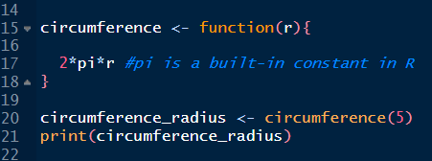
4. Calling Functions in R’
i. Use the function name followed by parenthesis, and add the necessary parameters inside the parenthesis function_name(parameters)
ii. A function must be called with the correct number of arguments.
iii. We usually assign the result to a variable, to be able to use it later
iv. When calling a function, parameters can be passed by position, by name, by mixing position-based and name-based matching and by omitting the arguments (uses set default values)

Slide 9
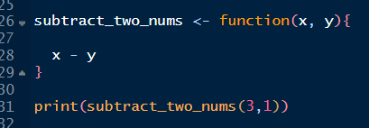
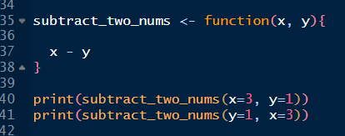
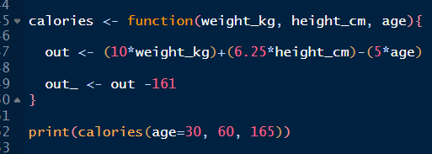
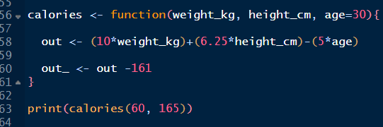
4. Contd’
Passing parameters by position
Passing parameters by name
Passing parameters by mixing position and name-based matching
Passing parameters by omitting some (or all)
We follow the same sequence of parameters as defined in the function.
Explicitly specify what value each parameter defined in the function takes.
The order of the parameters doesn't matter.
Named parameters are extracted and are matched first, while the remaining parameters are matched by position in the same order as they appear in the function definition.
Happens when we set some (or all) of the parameters to default values inside the function definition.

Slide 10
5. Nested Functions/Functions inside other Functions
We can define a new function inside another function (Nested Functions)
Inside the definition of an R function, we can use other functions.
We can pass the output of a called function directly as an argument to another function

Slide 11

6. Practicals
Demo of functions related to generating presentable descriptive/inferential tables and visualization plots (bar graphs, histograms, boxplots, stacked plots, line graphs)
The development of these functions was motivated by supermarket data in which we were interested in exploring grocery purchase patterns across 5 counties.
Demo Resources: https://github.com/reinpmomz/User_Defined_Functions_in_R_Training.git

Slide 12


Slide 13



THANK YOU
@APHRC
@aphrc
www.aphrc.org

